Slide 1

ARMORED CRUSADE

Slide 2

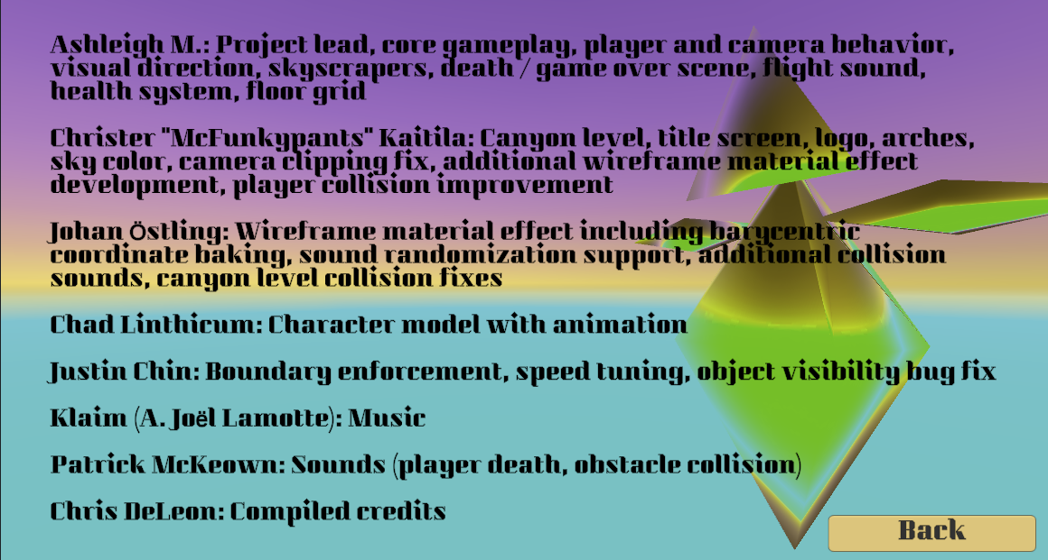
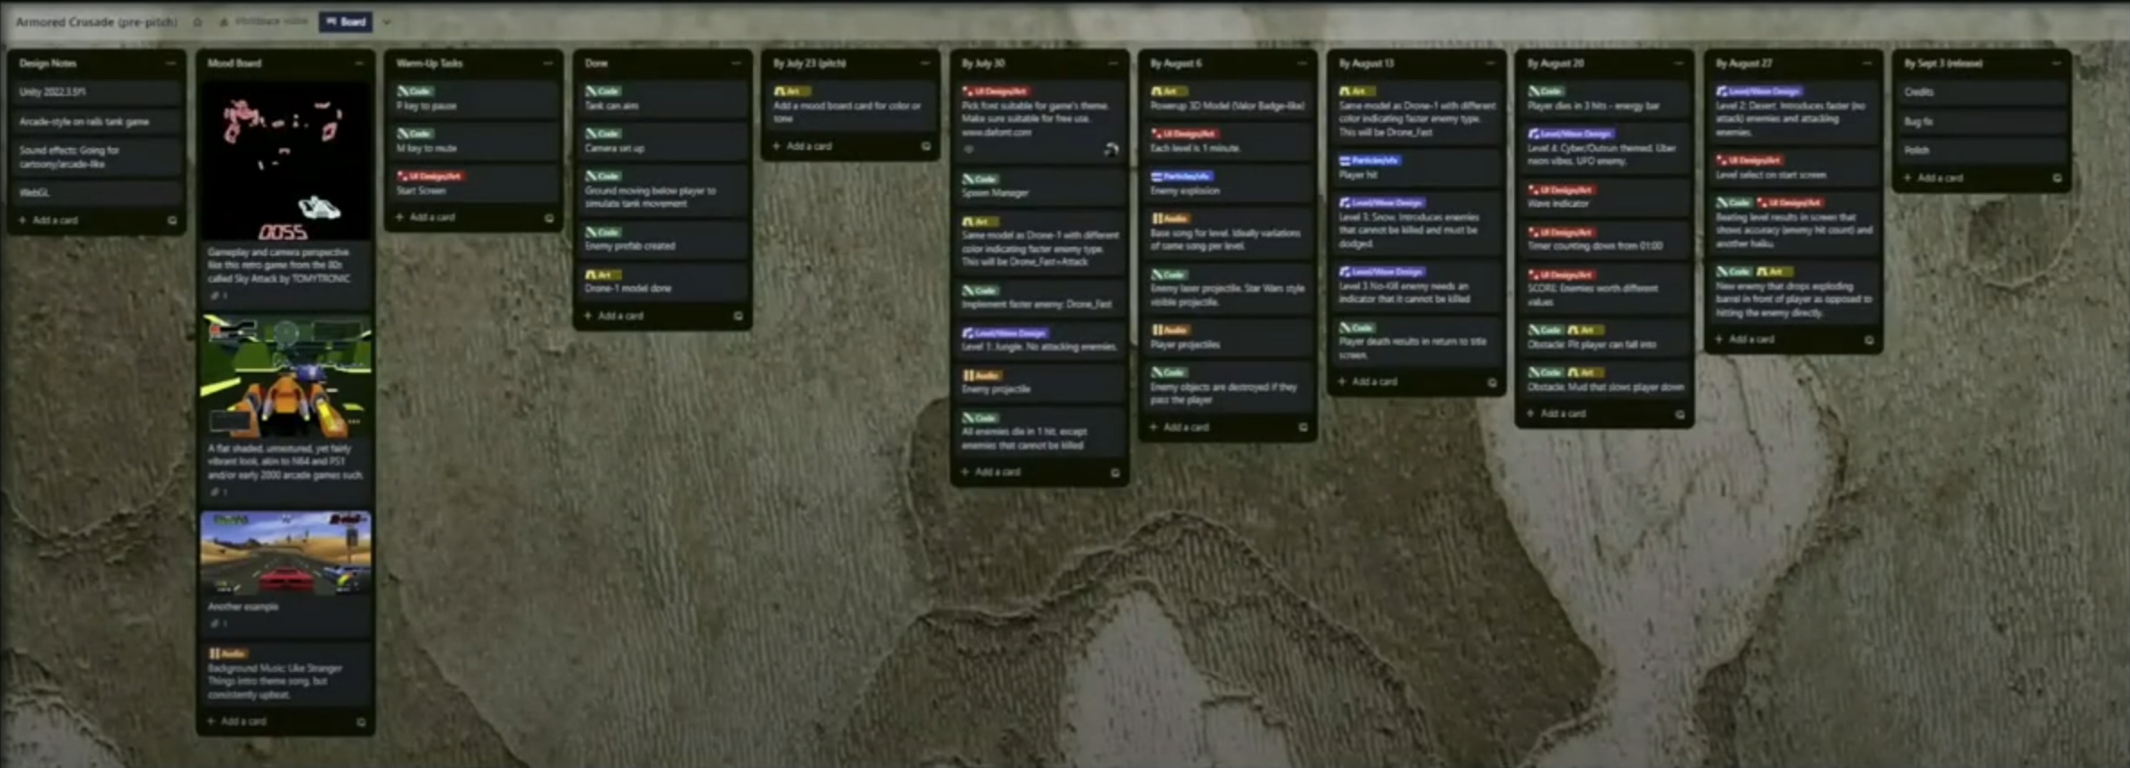
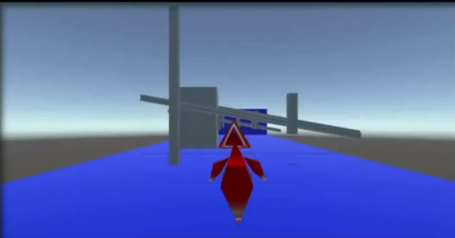
Home Team Game Dev
Previously enrolled for 4 months
Simulates a game dev environment working amongst other developers via GH and Slack
Guest speakers from the industry and other learning resources provided
You can contribute to other peoples’ games, and they can contribute to yours (if you’ve pitched one)

Slide 3
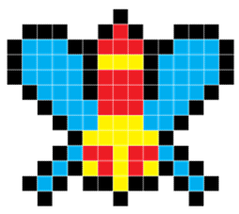

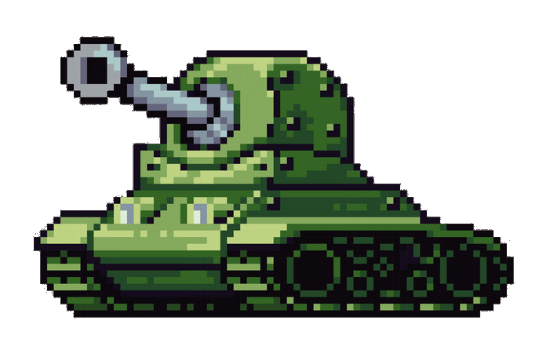
Genre
3D
Arcade-style
Action/Combat
High replay-ability (one more quarter)

Slide 4
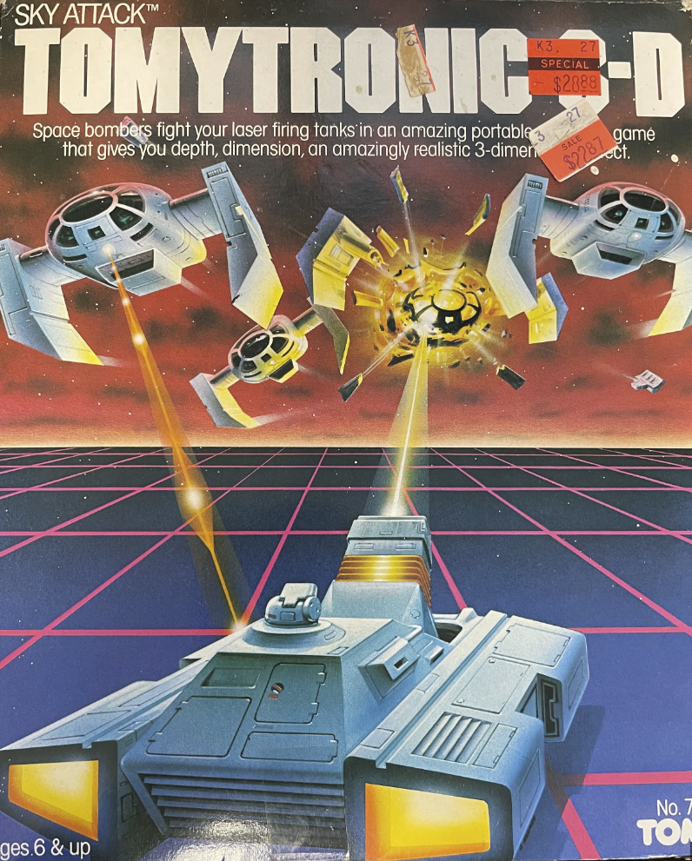
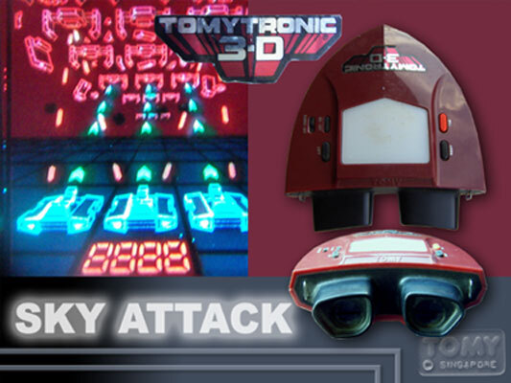
Inspiration
SKY ATTACK by Tomy
The Tomytronic 3D is a series of portable, handheld gaming devices released by Tomy. The device featured a strap so the player would be able to wear it around the neck in-between playing. The Tomytronic simulated 3D by having two LCD panels that were lit by external light through a window on top of the device. Released in 1983, it was the first dedicated home video 3D hardware
Like a View Master, but cooler still
90’s era N64/PS1 style graphics: Cyber Sled, Cruisin’ USA, WIPEOUT, Crazy Taxi, Virtual On
ARMORED CRUSADE is not a VR game
yet?

Slide 5

Goals
Proof of Concept:
Demonstrate the viability and potential of the core gameplay mechanics, vehicle design, and level structures that can be expanded upon in the future game.
Engaging Gameplay Mechanics:
Create dynamic and engaging gameplay mechanics that capture the essence of SKY ATTACK while adding new elements to enhance the player experience.
Implement smooth and responsive controls to ensure players feel in control of their armored vehicle.
Challenging Levels and Enemies:
Develop a series of progressively challenging levels of ground-based combat scenarios.
Introduce a range of enemy types with varying attack patterns, behaviors, and levels of difficulty to keep players engaged and provide a sense of progression.
Upgrades and Power-Ups:
Implement an upgrade system that allows players to enhance their armored vehicles' performance, firepower, and defensive capabilities over time.
Incorporate power-ups and collectibles throughout the levels to provide temporary boosts, special abilities, or unique weapons, adding depth to the gameplay.
Immersive Visuals and Audio:
Create visually appealing graphics that capture the spirit of the game and enhance the player's immersion.
Complement the visuals with an engaging soundtrack and sound effects that match the game's action and atmosphere.
Replayability and Progression:
Incorporate replayability elements such as achievements, leaderboards, or special challenges to encourage players to revisit levels and strive for better scores.
Design a progression system that rewards players with new vehicles, upgrades, or unlockable content as they advance through the game, providing a sense of accomplishment and motivation to keep playing.

Slide 6

Prototype/Demo
ARMORED CRUSADE serves as a prototype for what's to come, with a primary focus on refining and perfecting the gameplay mechanics that made SKY ATTACK so captivating. While aesthetics are important, the core goal of this prototype is to create an engaging and immersive gameplay experience, laying the foundation for an even more visually stunning and content-rich future game.

Slide 7
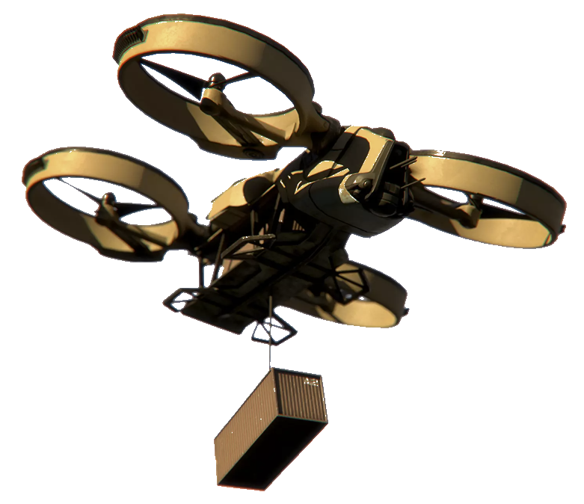
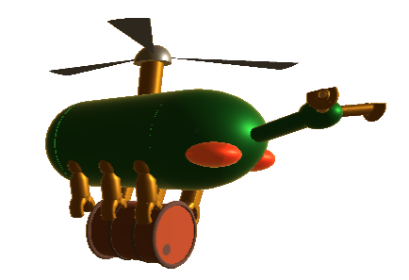

For example
ARMORED CRUSADE features a sci-fi artistic direction, exploring futuristic settings and enemies, vibrant colors, and imaginative designs. However, as the prototype potentially evolves into the final game, there would be a deliberate shift towards a more realistic aesthetic to align with the established style of the related games: Clean Sweep and Desert Strike

Slide 8
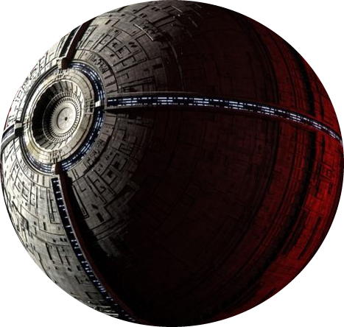

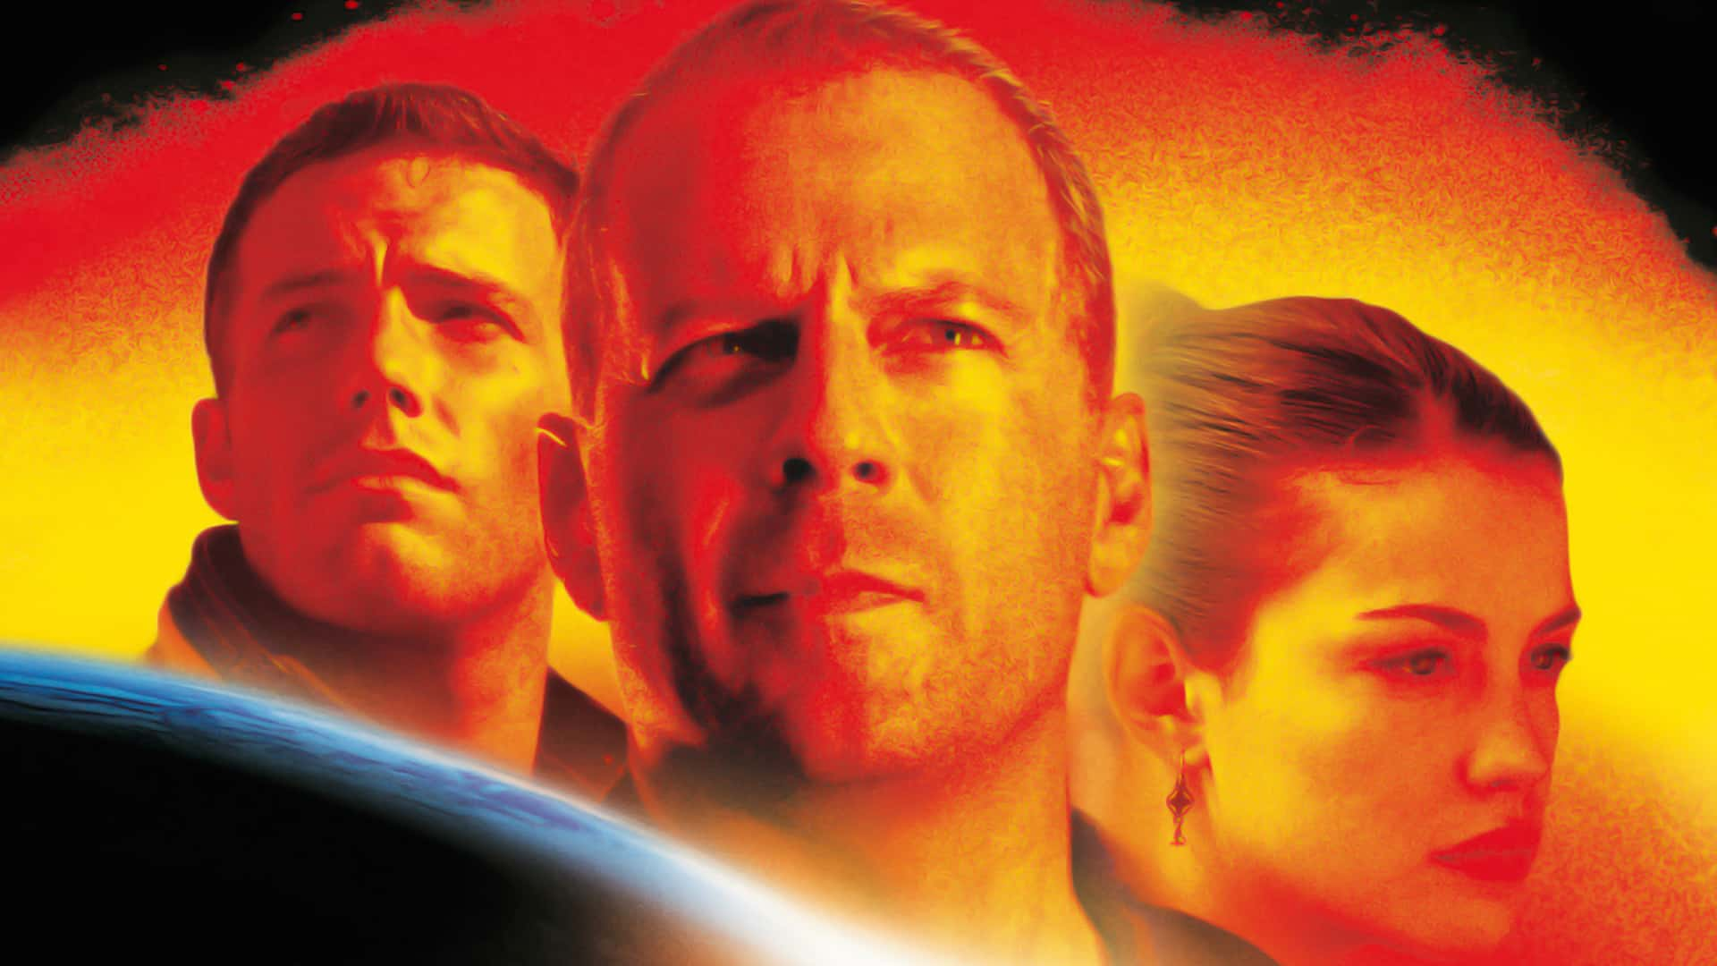
Lore
In a far-off past, a great distance away, the galaxy faces a grave threat from invasive drones that are wreaking havoc throughout the solar system, leaving destruction in their wake. These drones are controlled from a mysterious off-world moon, where a malevolent force seeks to conquer the entire galaxy. In response to this peril, a courageous group known as the ARMORED CRUSADE emerges to defend the galaxy and restore peace!
That’s no moon…

Slide 9
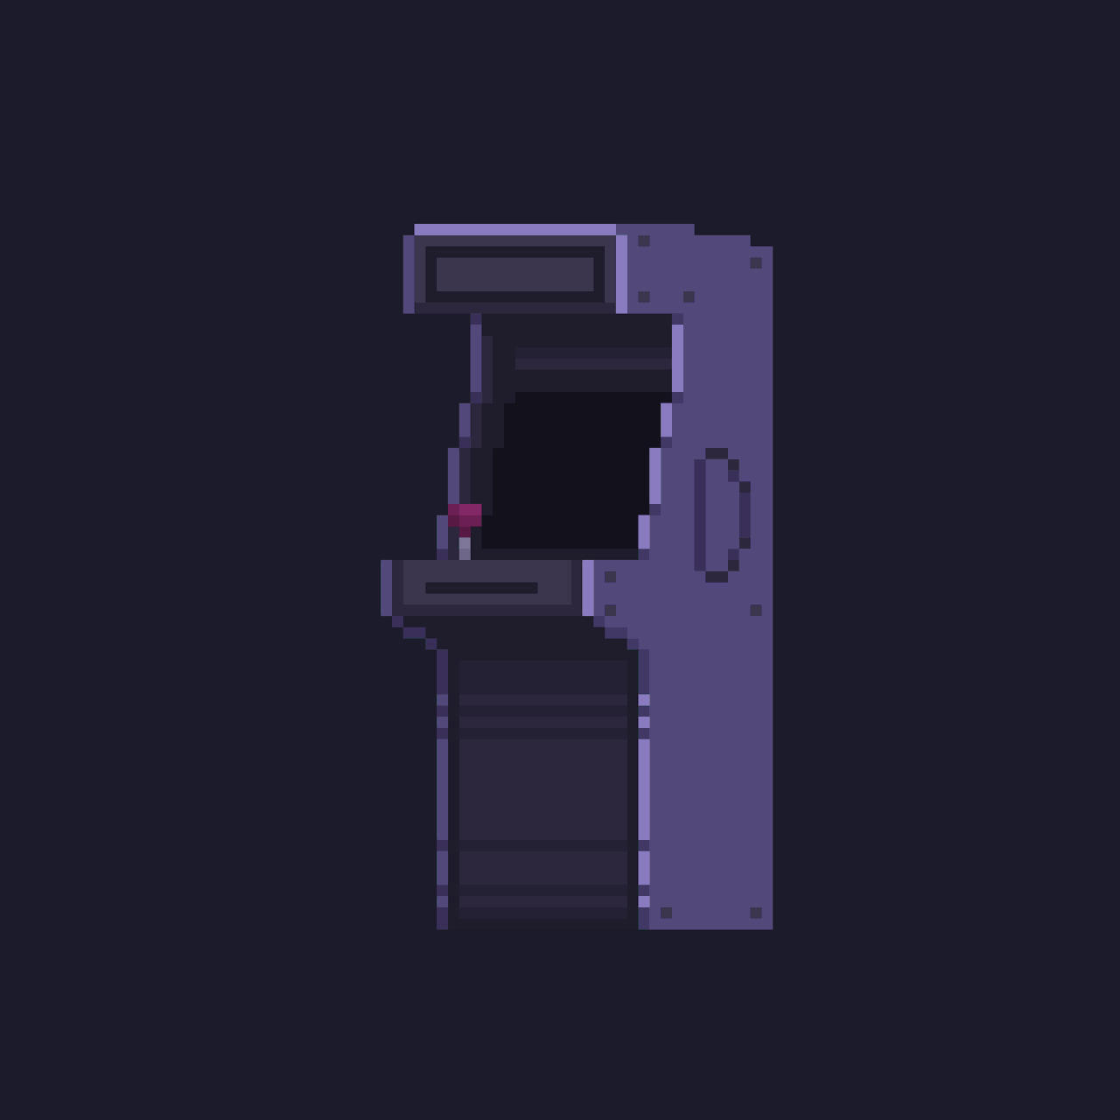
Game Time! Play it here: S:\user storage\chad\Armored Crusade

